Slide 1
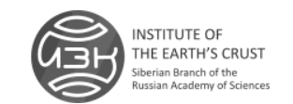
Institute of the Earth’s Crust, SB RAS:
Prospects for scientific collaboration
Dr. Tatiana Cherkashina
tcherk@irnok.net

Slide 2
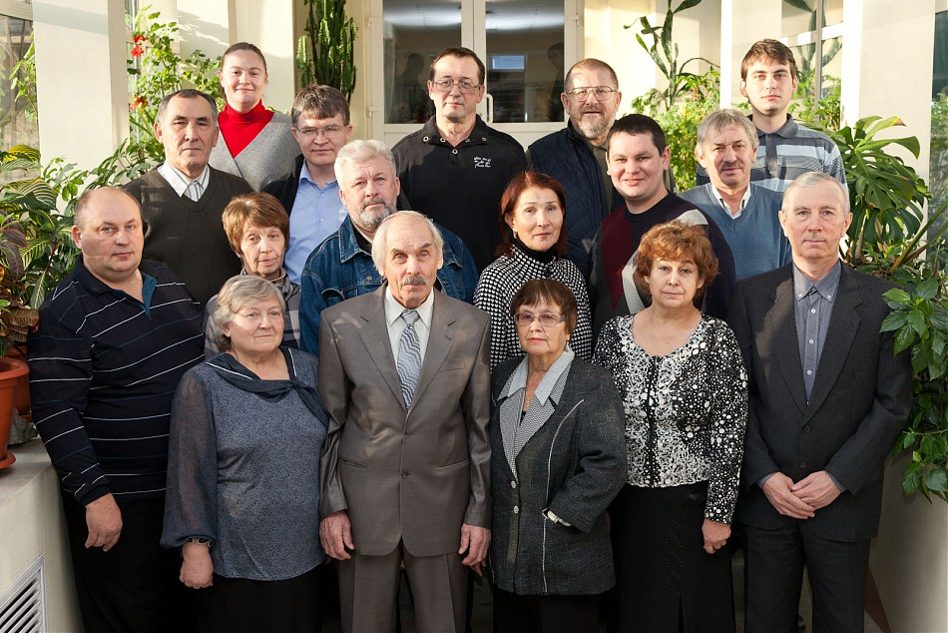
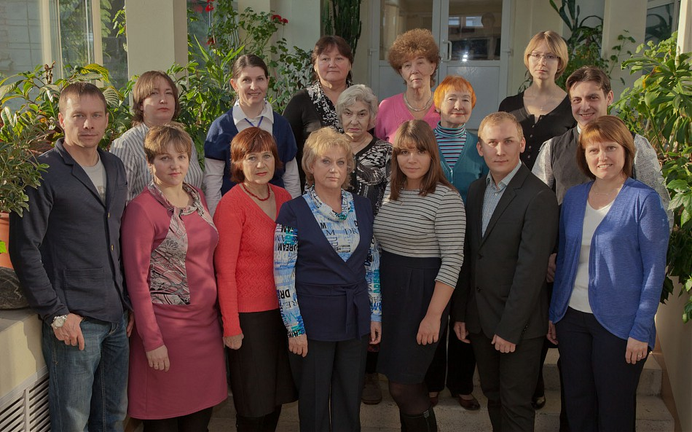
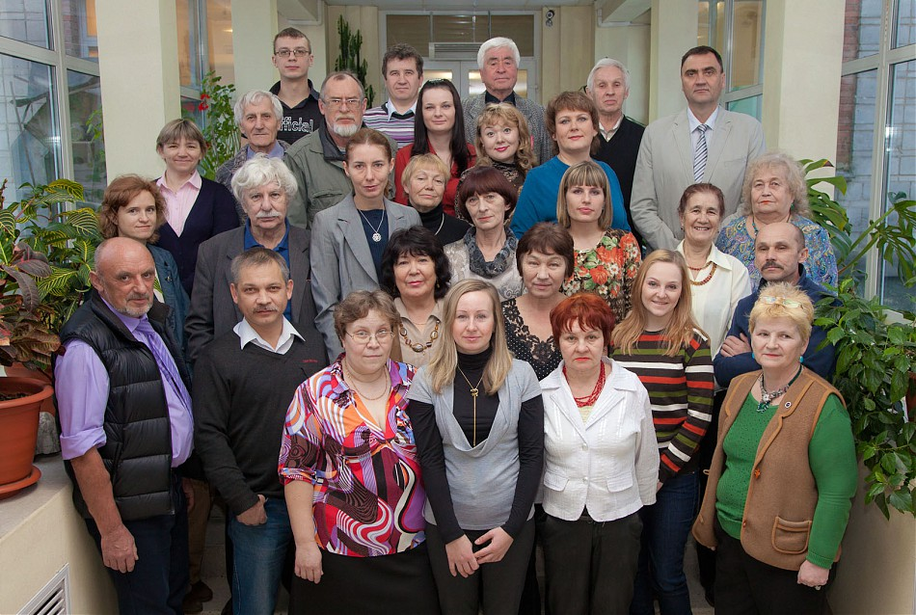
Institute of the Earth’s Crust: main scientific directions
The Institute was founded in 1949. Main scientific directions are the following:
Modern endo- and exogeodynamics. Geological environment and seismic processes.
Resources, groundwater dynamics and geoecology.
Internal structure, paleogeodynamics, endogenous processes and fluid dynamics of the continental lithosphere.
Laboratory of Engineering Seismology and Seismogeology
Laboratory of Engineering Geology and Geoecology

Slide 3
Main scientific achievements over the last five years
Regularities in the structure of the Earth's continental rift zones were revealed using examples from Eurasia, East Africa, and North America.
A comprehensive geodynamic model for the development of the Baikal rift zone has been created.
A working hypothesis for the search for diamonds has been developed and a predictive assessment of the diamond potential prospects in the south of the Siberian Platform has been carried out. A forecast map has been compiled for searching for diamonds in the Irkutsk region.
More than 15 new minerals have been discovered, including those from the rock-forming groups of pyroxenes, spinels, micas and tourmalines.
The Institute is a center for neotectonics, geomorphology and seismogeology. A paleoseismogeological method for assessing the level of seismic hazard has been developed, which has been widely used in Russia and abroad.
Monograph “Fundamentals of Hydrogeology” (6 volumes), two volumes of which were translated and published in Germany and England.
For the first time, for the territories of the south of Eastern Siberia with high activity of exogenous geological processes, an analysis of technogenic changes in the geological environment was carried out.

Slide 4
The Institute publishes the international scientific journal "Geodynamics and Tectonophysics" (http://www.gt-crust.ru). The journal is included in the Web of Science (Core Collection) and Scopus databases. There are two leading scientific schools at the Institute. Leaders: Academician of the Russian Academy of Sciences F.A. Letnikov and corresponding member of RAS E.V. Sklyarov. The Institute has cooperation with universities: Irkutsk National Research Technical University (IRNTU) and Irkutsk State University (ISU). Joint research laboratories have been created: geophysical, tectonophysical, and modern research methods in dynamic and engineering geology. In 2015, the Center for Geodynamics and Geochronology was created (supervised by Professor A.V. Ivanov). In 2017, to combine geophysical research, the Unique Scientific Installation “South Baikal Instrumental Complex for Monitoring Hazardous Geodynamic Processes” was created.
Based on the results of assessing the effectiveness of scientific activities carried out in 2017, the Institute was classified in the first (highest) category of academic institutions in Russia.

Slide 5
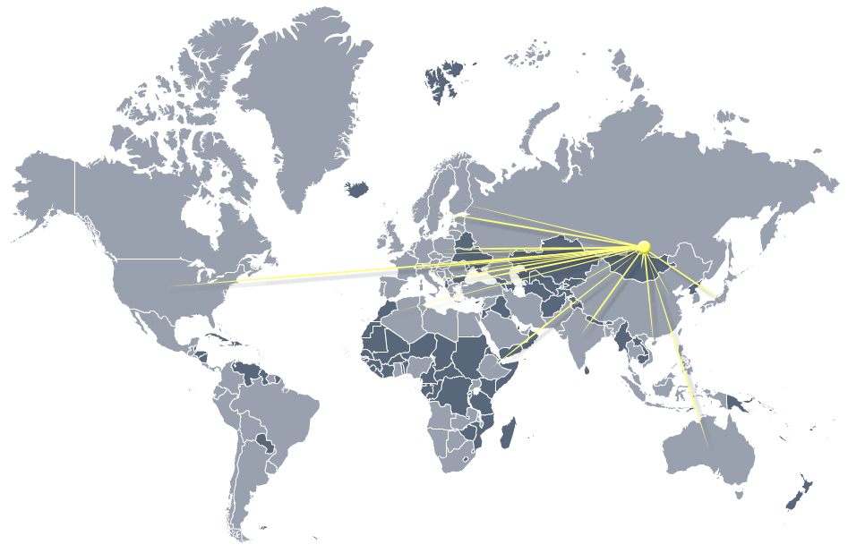

World communications
The Institute actively develops international cooperation, namely, researchers participate in International conferences held in various countries of Europe, Africa, Asia, as well as in the USA and Australia.
Close cooperation is noted with scientists from France, Belgium, Germany, China, Australia, Poland, Japan and Mongolia.

Slide 6
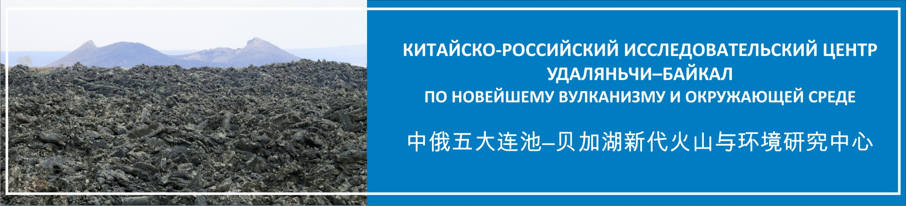
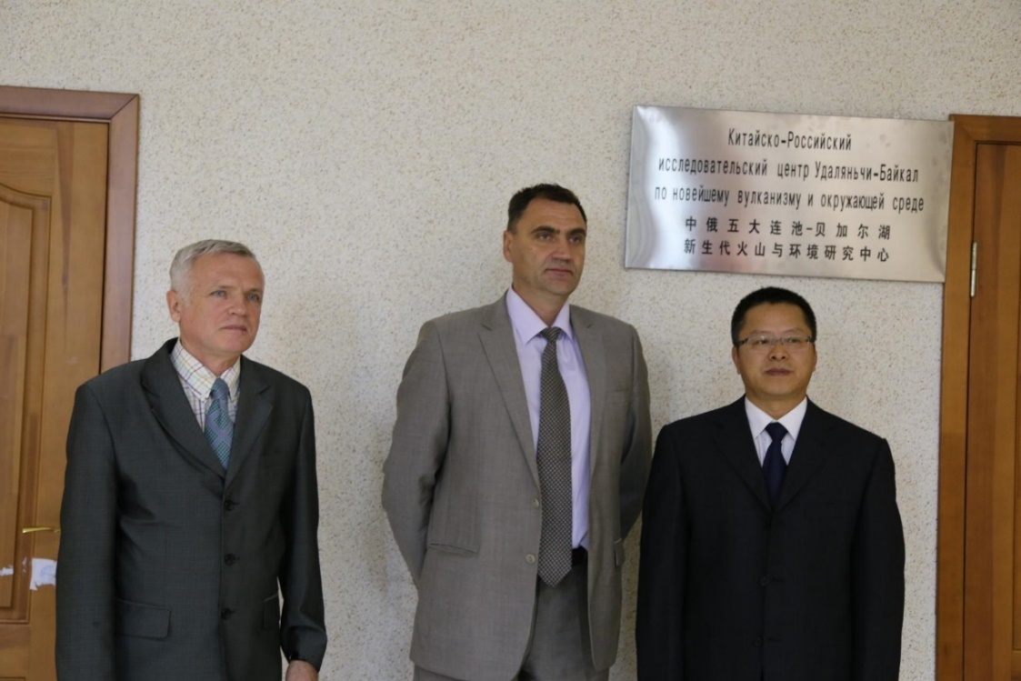
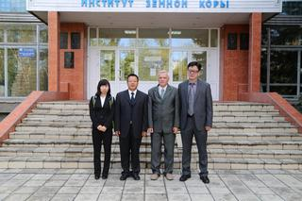
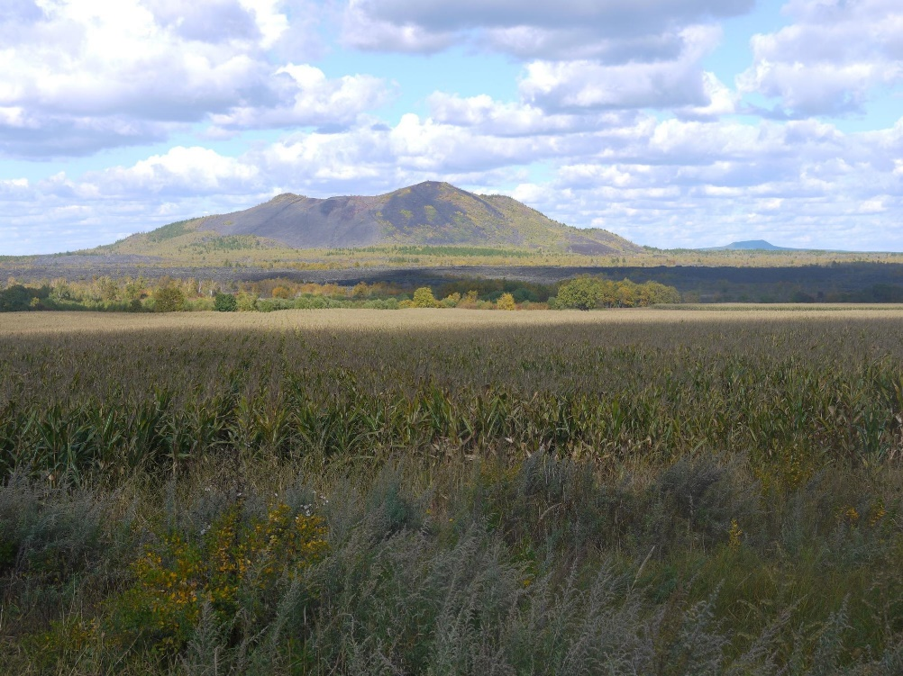
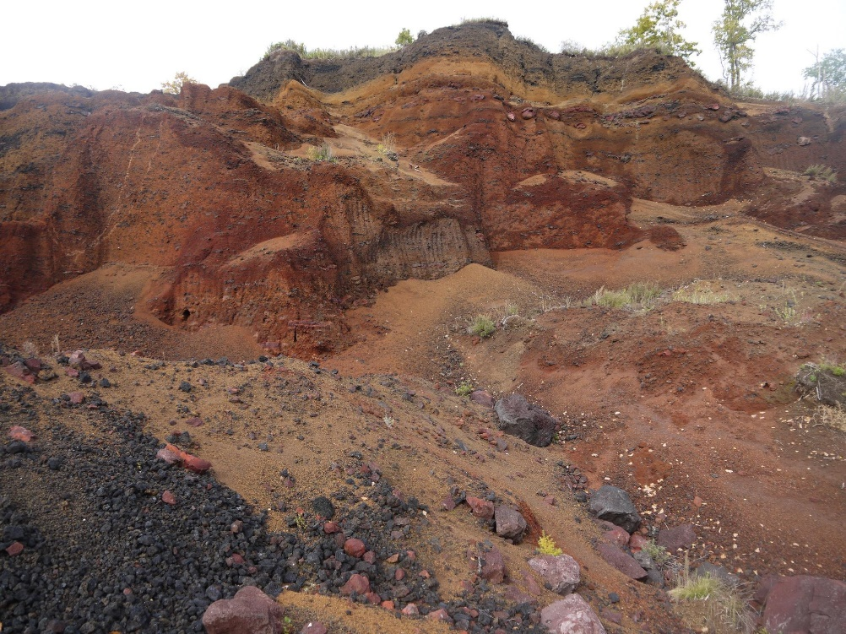
China-Russia Udalyanchi-Baikal Research Center on Recent Volcanism and Environment
In 2015, an agreement was signed between the Institute of the Earth's Crust SB RAS and the Institute of Volcanology and Mineral Springs of the Academy of Sciences of Heilongjiang Province.
Laohei Shan volcano, eruption 1720
Mukhenanshan
volcano quarry

Slide 7

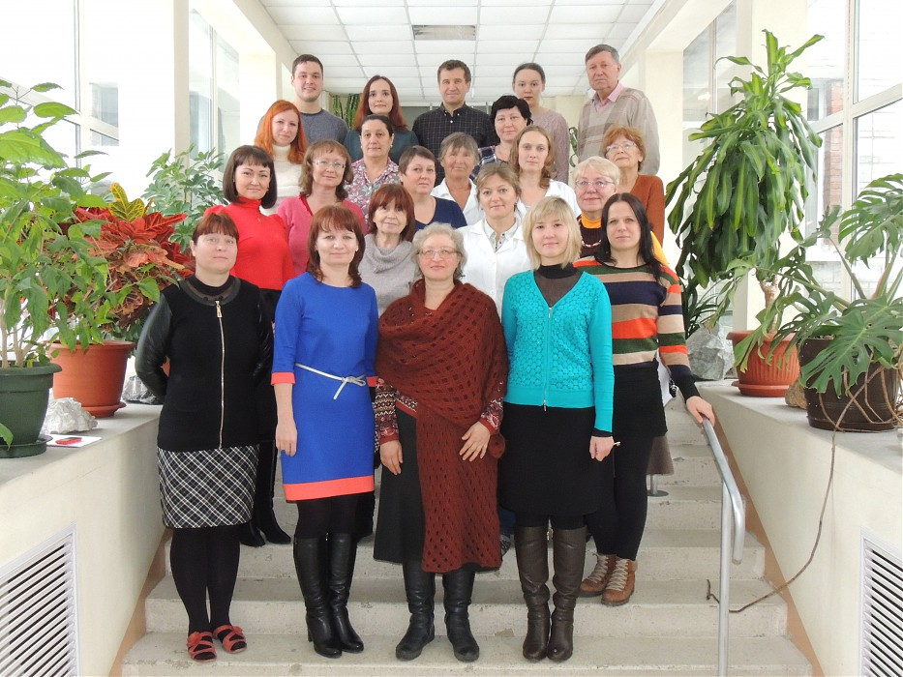
Center for Geodynamics and Geochronology
Institute of the Earth’s Crust, SB RAS
In 2015, the Center for Geodynamics and Geochronology was created on the base of the Analytical Center. Head of the Center – Doctor of Sciences in geology and mineralogy, prof. Alexey Ivanov.
In 2019, our Institute won the Megagrant competition held by the Ministry of Science and Higher Education of the Russian Federation. As a part of this project, the Orogenesis laboratory was created under the head of Doctor of Sciences in geology and mineralogy
S.A. Pisarevsky (Australia).
Project title: “Orogenesis: the formation and growth of continents and supercontinents.”
In 2020, the Institute became a participant in the implementation of a Big scientific project “Fundamentals, methods and technologies for digital monitoring and forecasting of the environmental situation on the Baikal natural territory” supported by the Ministry of Science and Higher Education of the Russian Federation (supervisor is academician I.V. Buchkov).
In 2021, our Institute won the competition "Development of material and technical infrastructure of Centers for the collective use with new scientific equipment" held by the State program "Scientific and technological development of the Russian Federation".
Supervisor is director of our Institute, corresponding member D.P. Gladkochub.

Slide 8
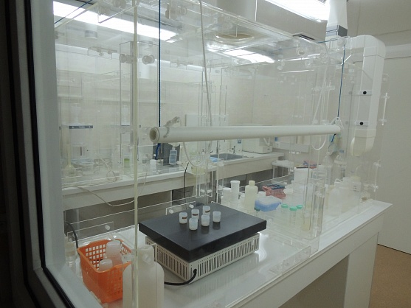
Center for Geodynamics and Geochronology
Institute of the Earth’s Crust, SB RAS
http://www.en.crust.irk.ru/lab08.html
The Center includes clean rooms block for sample preparation; It is assigned a class 1,000 cleanroom (ISO 6), Standard ISO 14644-1.

Slide 9
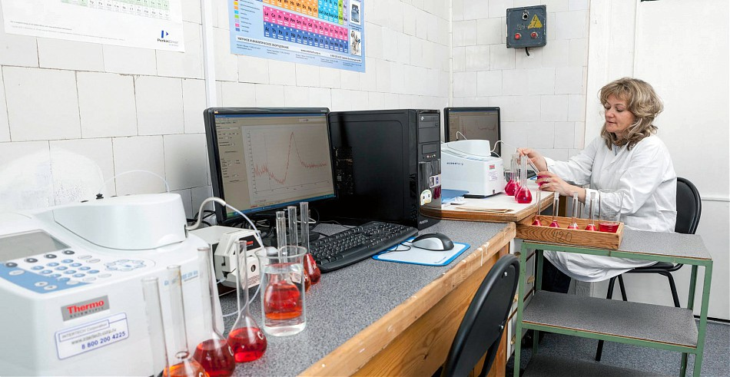
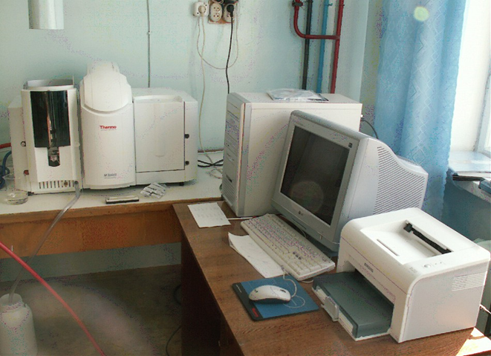
Chemical analysis department
Spectrophotometric complex Genesys 10S (Thermo Fisher Scientific, USA) allows us to determine the SiO2, TiO2, Al2O3, Fe2O3, FeO, P2O5 contents in different types of rocks, soils, ores, and sediments.
Atomic absorption spectrometer Solaar M6
(Thermo Electron Corp., USA) with a Zeeman correction system.
This equipment is applied for the measuring Fe2O3(tot), MnO, CaO, MgO, K2O, Na2O, Li, Rb, and Sr in rocks, soils, ores, and sediments.

Slide 10
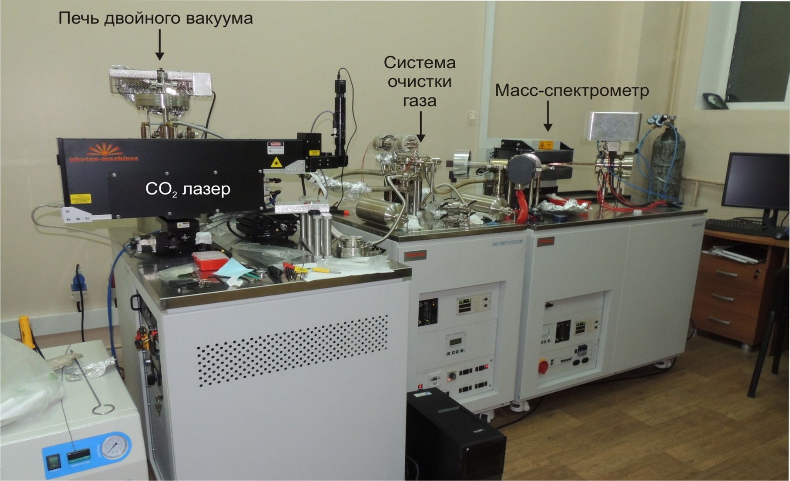
Isotope analysis department
Mass spectrometric complex ARGUS-VI (Thermo Fisher Scientific, USA)
This complex is applied for the precision argon analysis. It implements modern technologies for isotopic analysis of ultra-small volumes of noble gas samples (He, Ne, Ar etc.).

Slide 11
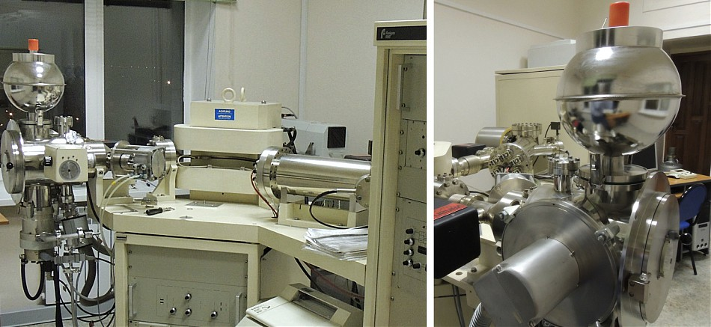
Multicollector mass spectrometer Finnigan MAT 262 (Thermo Fisher Scientific, USA)
With this mass spectrometer it is possible to determine Rb/Sr, Sm/Nd, and U/Pb isotope ratios in rocks, minerals and natural waters.

Slide 12
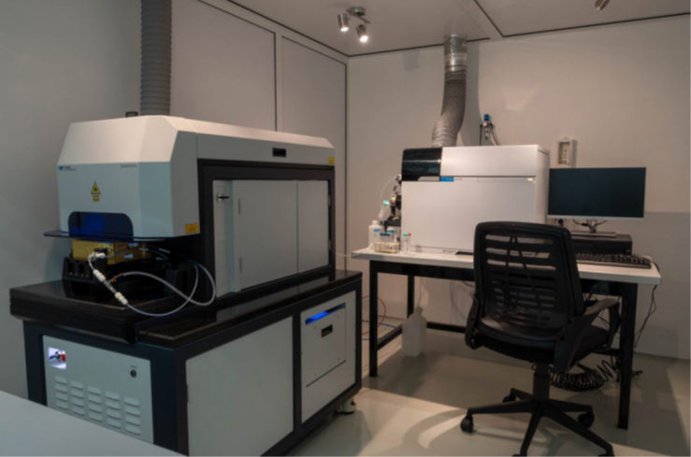
Inductively coupled plasma mass spectrometer (ICP-MS) Agilent-7900
with laser ablation system (LA-MS-ICP) Analyte Excite
The laser ablation system makes it possible to analyze the chemical and isotopic composition of different geological materials in the solid state, including U-Pb isotope dating of minerals. The ICP-MS method is multi-element, highly sensitive, high-speed with a wide range of measurement of element concentrations.

Slide 13
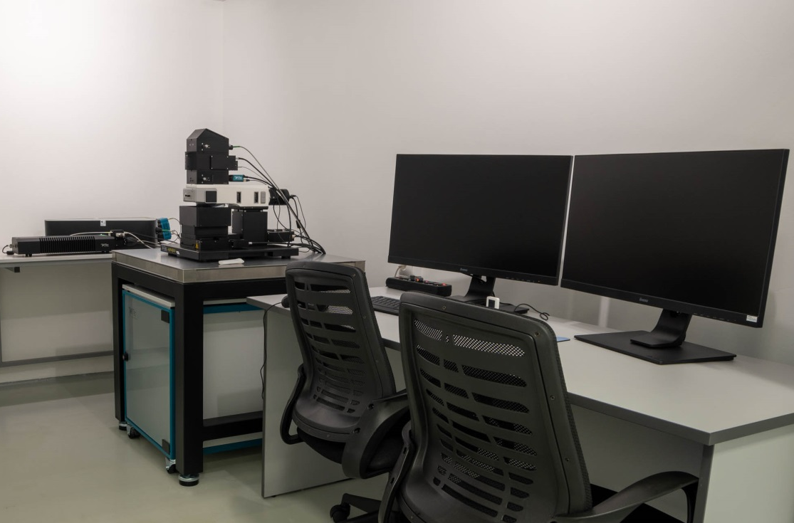
Confocal Raman scattering spectroscopy.
System WITec Alpha 300R (WITec GmbH, Германия)
Raman spectroscopy is a non-contact, non-destructive method for local analysis of the molecular composition of a substance (solid, liquid or gaseous). System for the Raman spectroscopy includes Solid State Laser, four microlenses, UHTS300 lens spectrometer, and other measuring devices.
In geology, this method is used to identify minerals and study inclusions in minerals: solid, gas-liquid and melt.

Slide 14
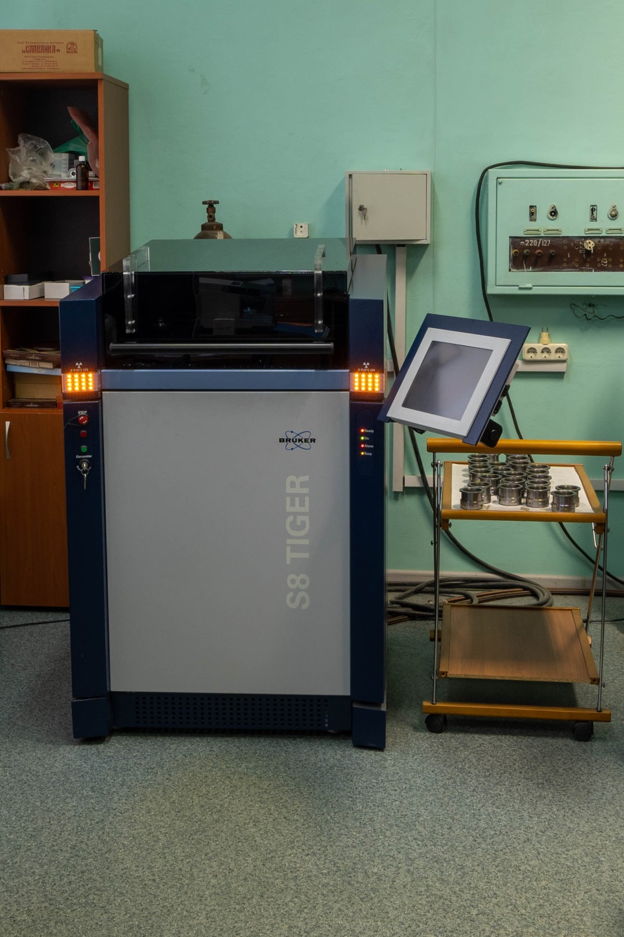
X-RAY FLUORESCENCE ANALYSIS DEPARTMENT
Wavelength dispersive X-ray fluorescence spectrometer S8 TIGER (Bruker AXS, Germany)
X-ray fluorescence analysis is a rapid, reliable, quantitative, and non-destructive spectroscopic technique, allows performing a direct analysis of different solid samples without extensive pretreatment.
Determining rock-forming and trace element contents in different types of rocks, sediments, soils, ores, minerals, and archaeological objects.

Slide 15
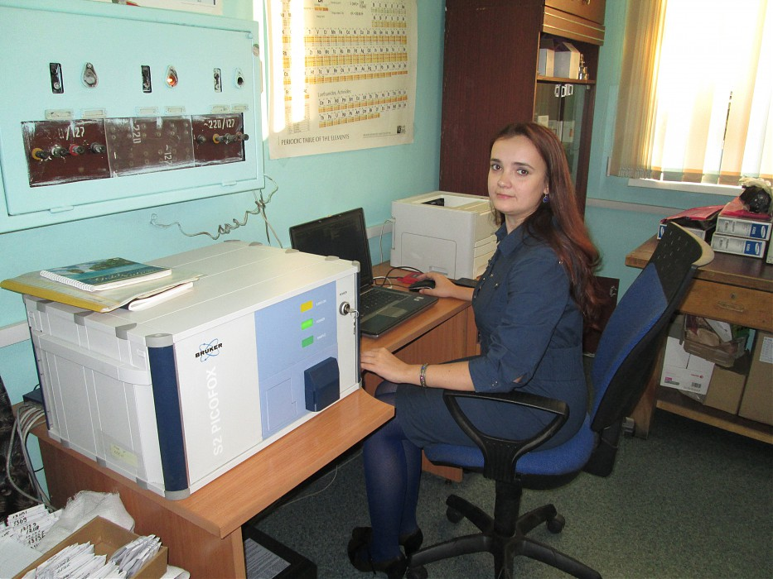
X-RAY FLUORESCENCE ANALYSIS DEPARTMENT
Total reflection X-ray fluorescence spectrometer S2 PICOFOX
(Bruker AXS, Germany)
Currently, the Institute's Center has developed methods for studying natural and tap water, alcoholic and non-alcoholic drinks, milk (13 elements), fresh water, brines, different types of rocks, ores, minerals, sediments, and soils.
The determined concentrations are from the first ppm to close 100 %.

Slide 16
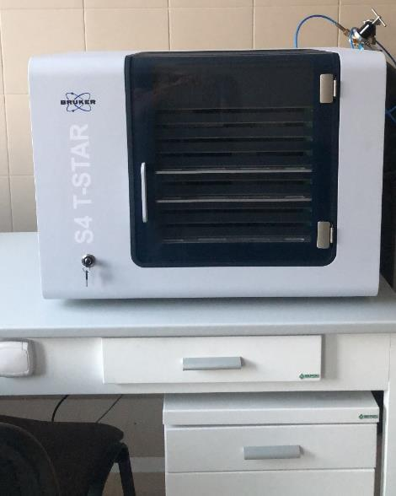
X-RAY FLUORESCENCE ANALYSIS DEPARTMENT
Total reflection X-ray fluorescence spectrometer S4 T-Star
(Bruker AXS, Germany)
Determination of elements (from Mg to U) in various objects, such as rocks, ores, minerals, natural waters, brines, and archaeological artifacts.
This spectrometer has two X-ray tubes with Mo- and W-anodes, which make it possible to expand the range of elements being determined.
The device has high sensitivity at the ppb–% concentration level.
It is possible to analyze a small amount of a substance - about 50 mg or ml.

Slide 17
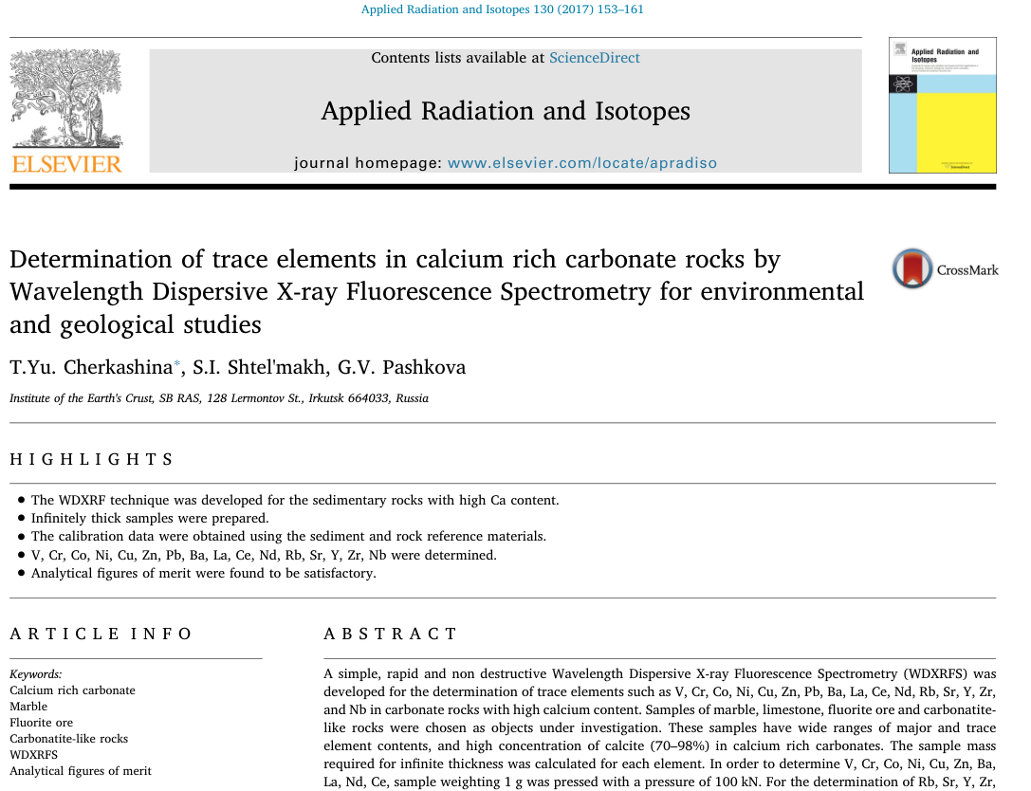
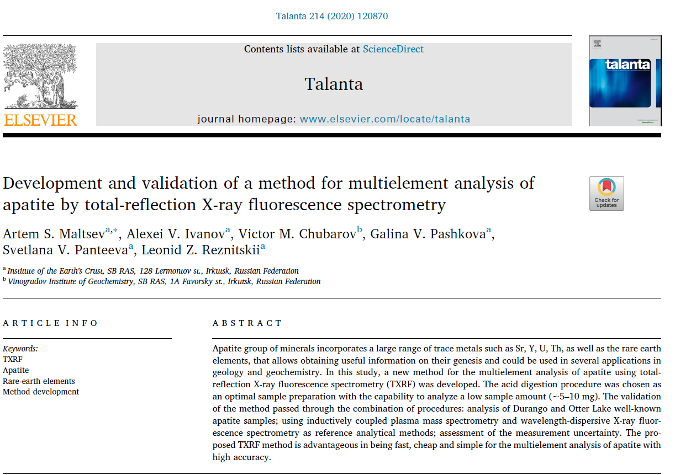
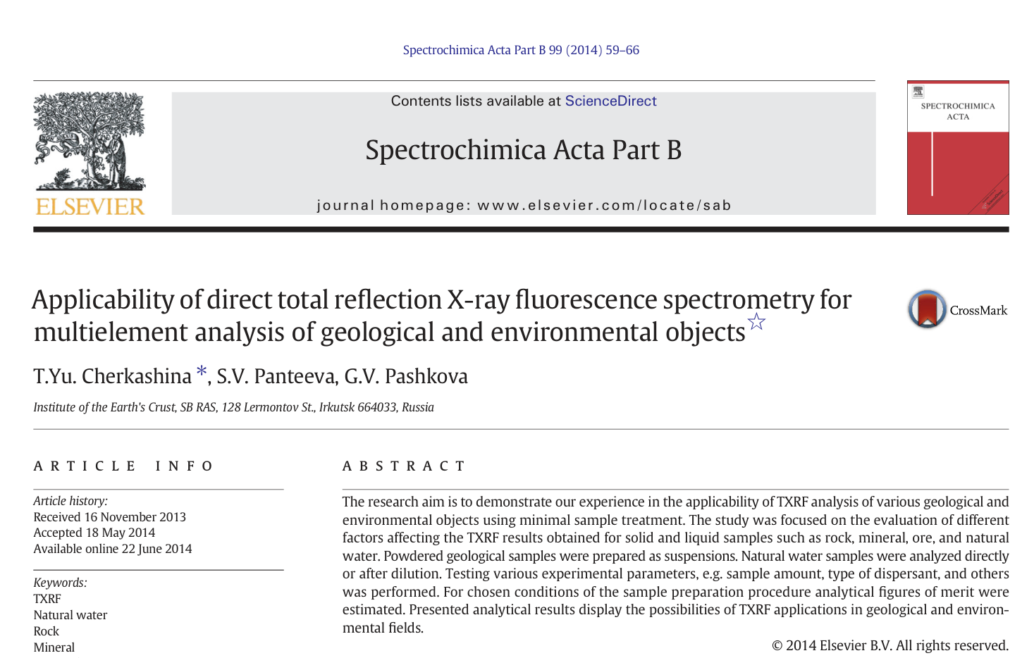

Slide 18
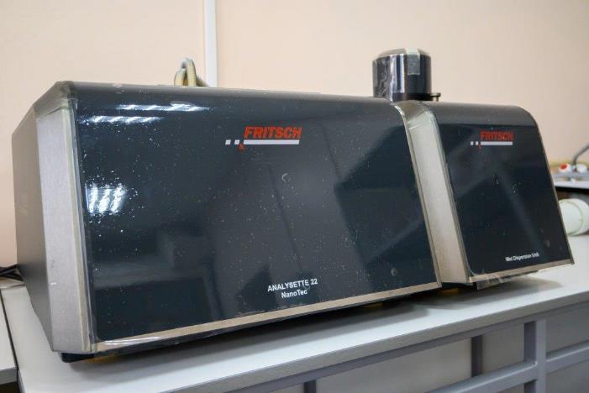
ENGINEERING GEOLOGY AND GEOECOLOGY DEPARTMENT
Laser particle-size analyzer
ANALYSETTE 22 NanoTec (FRITSCH, Germany) for granulometric analysis of particles with size in the range from
0.01 to 2000 µm.
Main goals of granulometric analysis:
measurement of particle size distribution in loose grounds, powders, suspensions, pastes;
production and quality control of samples;
determination of the lithogenesis regime of loose sediments.

Slide 19
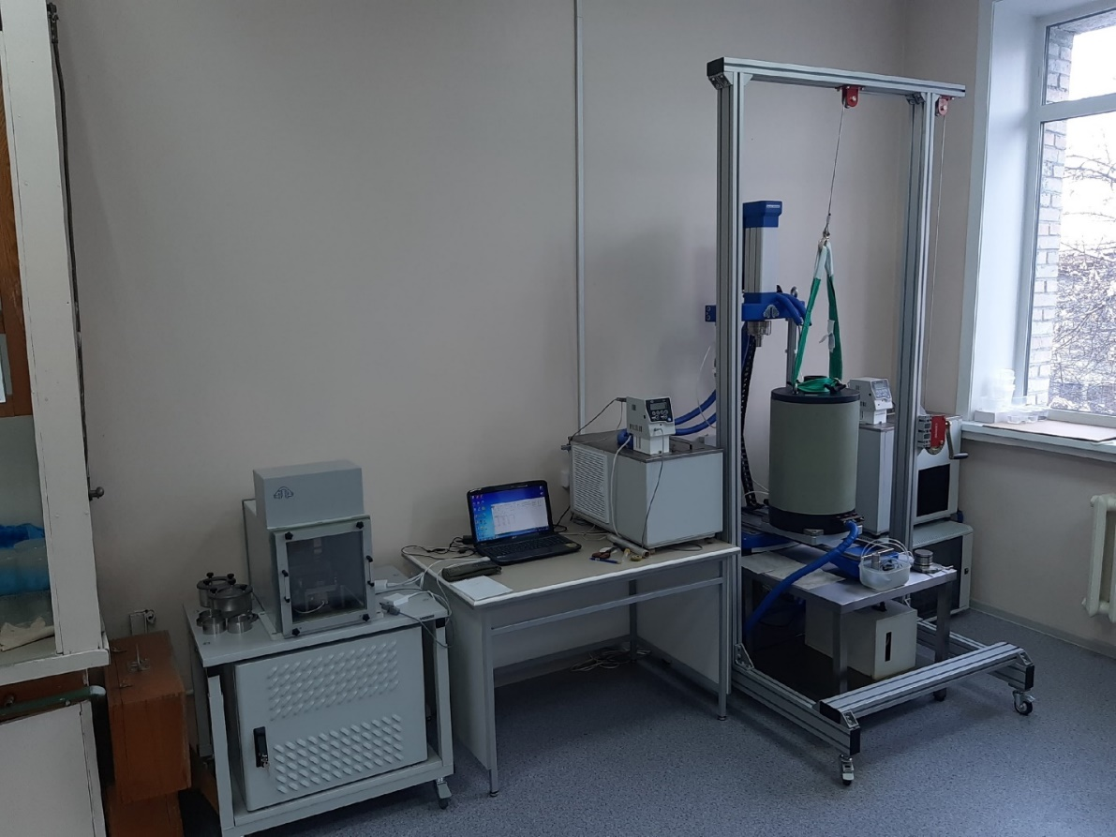
Automated complex "ASIS" (Russia) for studying the mechanical properties of thawed and frozen grounds
Ground testing is carried out using the triaxial compression method to study strength, deformation and rheological characteristics, such as moduli of elasticity, deformation, shear and others.
All tests are carried out in accordance with GOST 12071-2000 (Russia).

Slide 20
Assessment of metal pollution and ecological risk in the coastal zone of Olkhon
Island, Lake Baikal
This assessment was performed for sand
samples using geochemical indices.
The following results were obtained:
The flowchart of the analytical methodology for this study was presented.
Heavy metal pollution ranged from moderate to significant levels for Hg, As, Cd, Pb, and Cu.
Hg, Cd, and Pb are the pollutants, which pose high ecological risk for the study area.
Pearson correlation analysis indicated high
positive correlation between Pb and Hg,
As and Cd, Cd and Pb, that reflects the same
origin source and migration pathway.
These results allows to use this study as a model for the assessment of heavy metal contamination level in different areas.

Slide 21
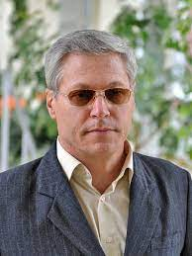
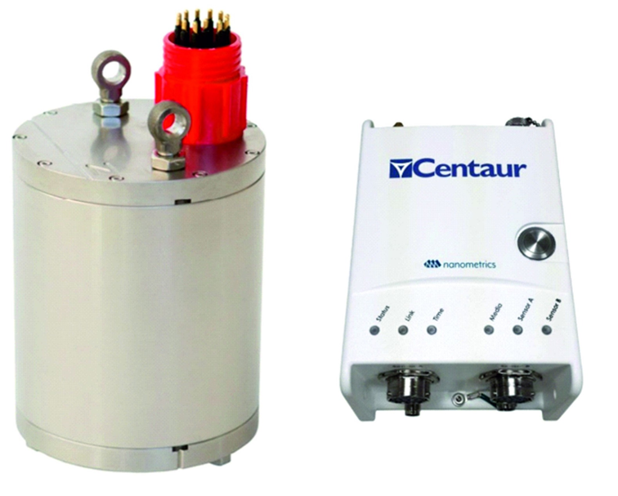
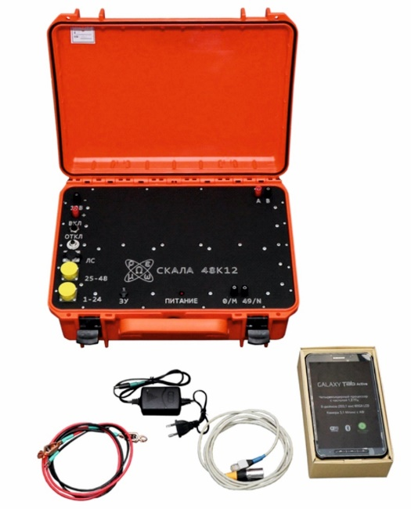
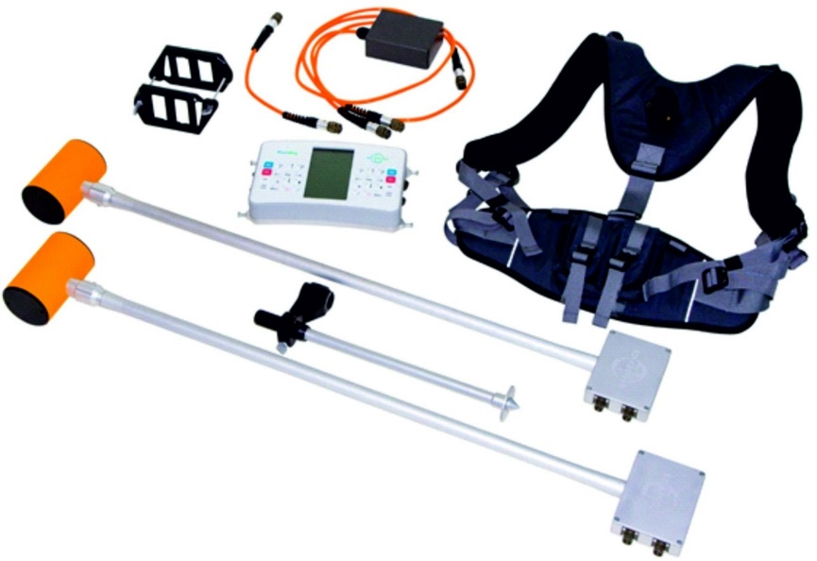

DEPARTMENT OF GEOPHYSICAL RESEARCHES
Unique Scientific Installation "South Baikal instrumental complex for monitoring hazardous geodynamic processes"
Head of the Unique Scientific Installation - Doctor of Geological and Mineralogical Sciences Seminsky Konstantin.
This scientific installation includes a set of modern scientific equipment for studying deformations and seismic vibrations of the earth's crust. This allows us to model the relationship between the modern geodynamics of the Baikal rift zone and collision processes occurring on the margins of the Eurasian plate, and study seismicity in the Baikal rift zone, as well as provide medium- and short-term earthquake forecasts.

Slide 22
PROPOSALS FOR COLLABORATION
Our institute deals with dozens of scientific directions in the field of natural science. Some of these require developing mathematic methods and data processing techniques:
Statistical
Machine learning AI (artificial intelligence)
Modeling natural phenomena and processes
Information systems (IS) aggregating the monitoring data from field sensors
Analytical subsystems for these IS
Spatially distributed data representation as GIS (geographic informational systems)

Slide 23
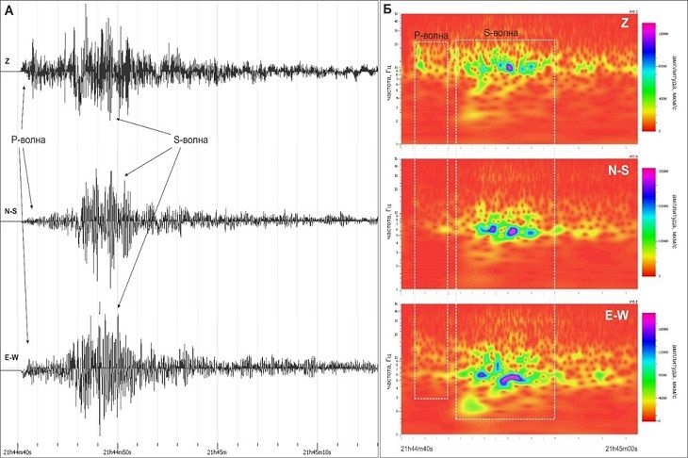
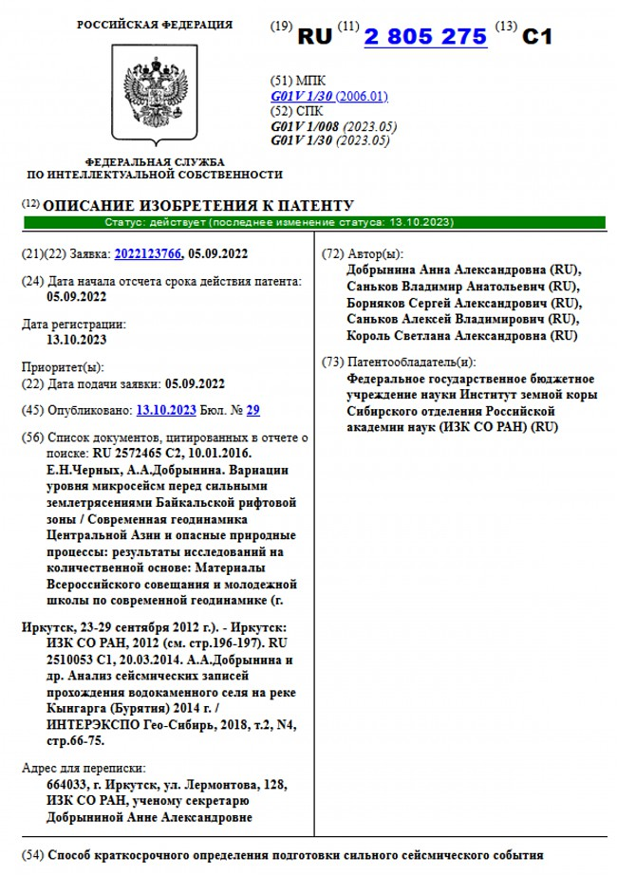
Currently, scientists at our Institute have patented a method for short-term determination of the approach of a strong seismic event.
This method solves the problem of increasing the reliability of short-term determination of the approach of a strong seismic event with the indication of the location of this event. The data for this method are obtained by monitoring seismic noise in lithospheric zones. Registration of changes in the forecast parameter takes place in the period from several days to several hours.
These studies and patent registration were carried out within the framework of the Big Project on Lake Baikal Monitoring of the Ministry of Education and Science, headed by Academician Igor Bychkov.

Slide 24
Predicting dangerous geological processes is carried out in collaboration with Institute of Computational Mathematics and Mathematical Geophysics SB RAS. This technique is based on data mining and machine learning AI.
Our interest is application of the existing experience of China colleagues in the field of machine learning AI.
The research proposal is in the field of earthquakes forecasting, classifying anomalies in time series, training neural networks on a limited data set, and building complex models that are capable of making decisions in real time by analyzing data from various sources (e.g. spatially distributed sensors).

Slide 25
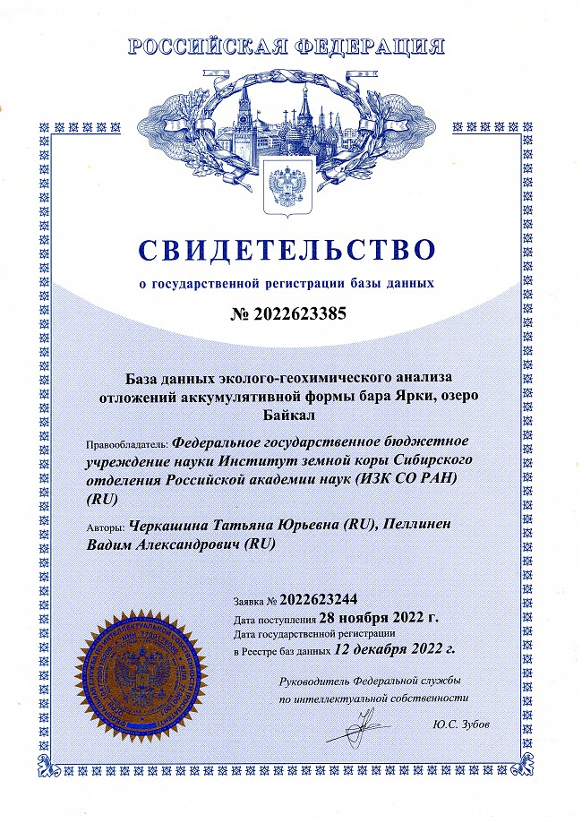
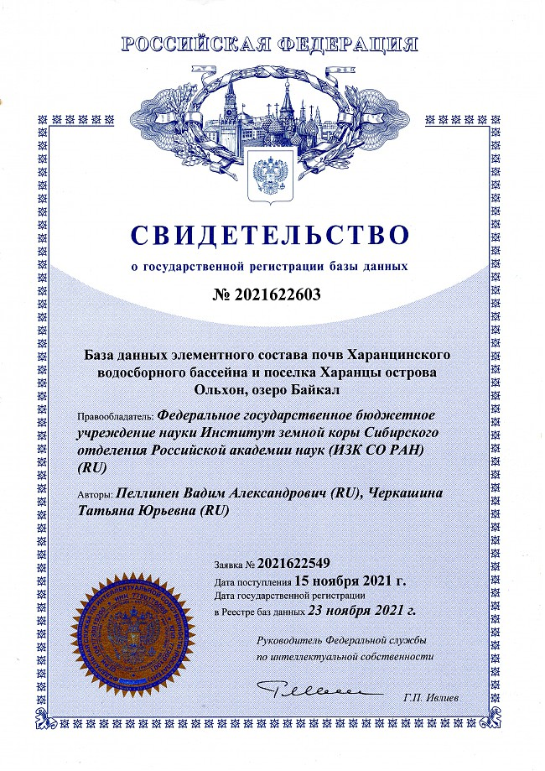
ENGINEERING GEOLOGY AND GEOECOLOGY DEPARTMENT
Increasing anthropogenic impact on the Baikal ecosystems results in a deviation of their normal conditions, emerges ecological risks. These risks can be evaluated with geochemical methods. Chemical compositions of soils, sediments, natural waters are important indicators of environmental changes.
We patented two databases of chemical composition of soils from forest and inhabitant territories in Olkhon Island (Lake Baikal). The most complex problem is modeling transfer of hazardous chemical elements, because the presence of significant contents of heavy metals can cause negative toxic effects in coastal geosystems.
It will give rise the possibility of long-term geochemical assessment of ecological conditions on the territory studied.

Slide 26
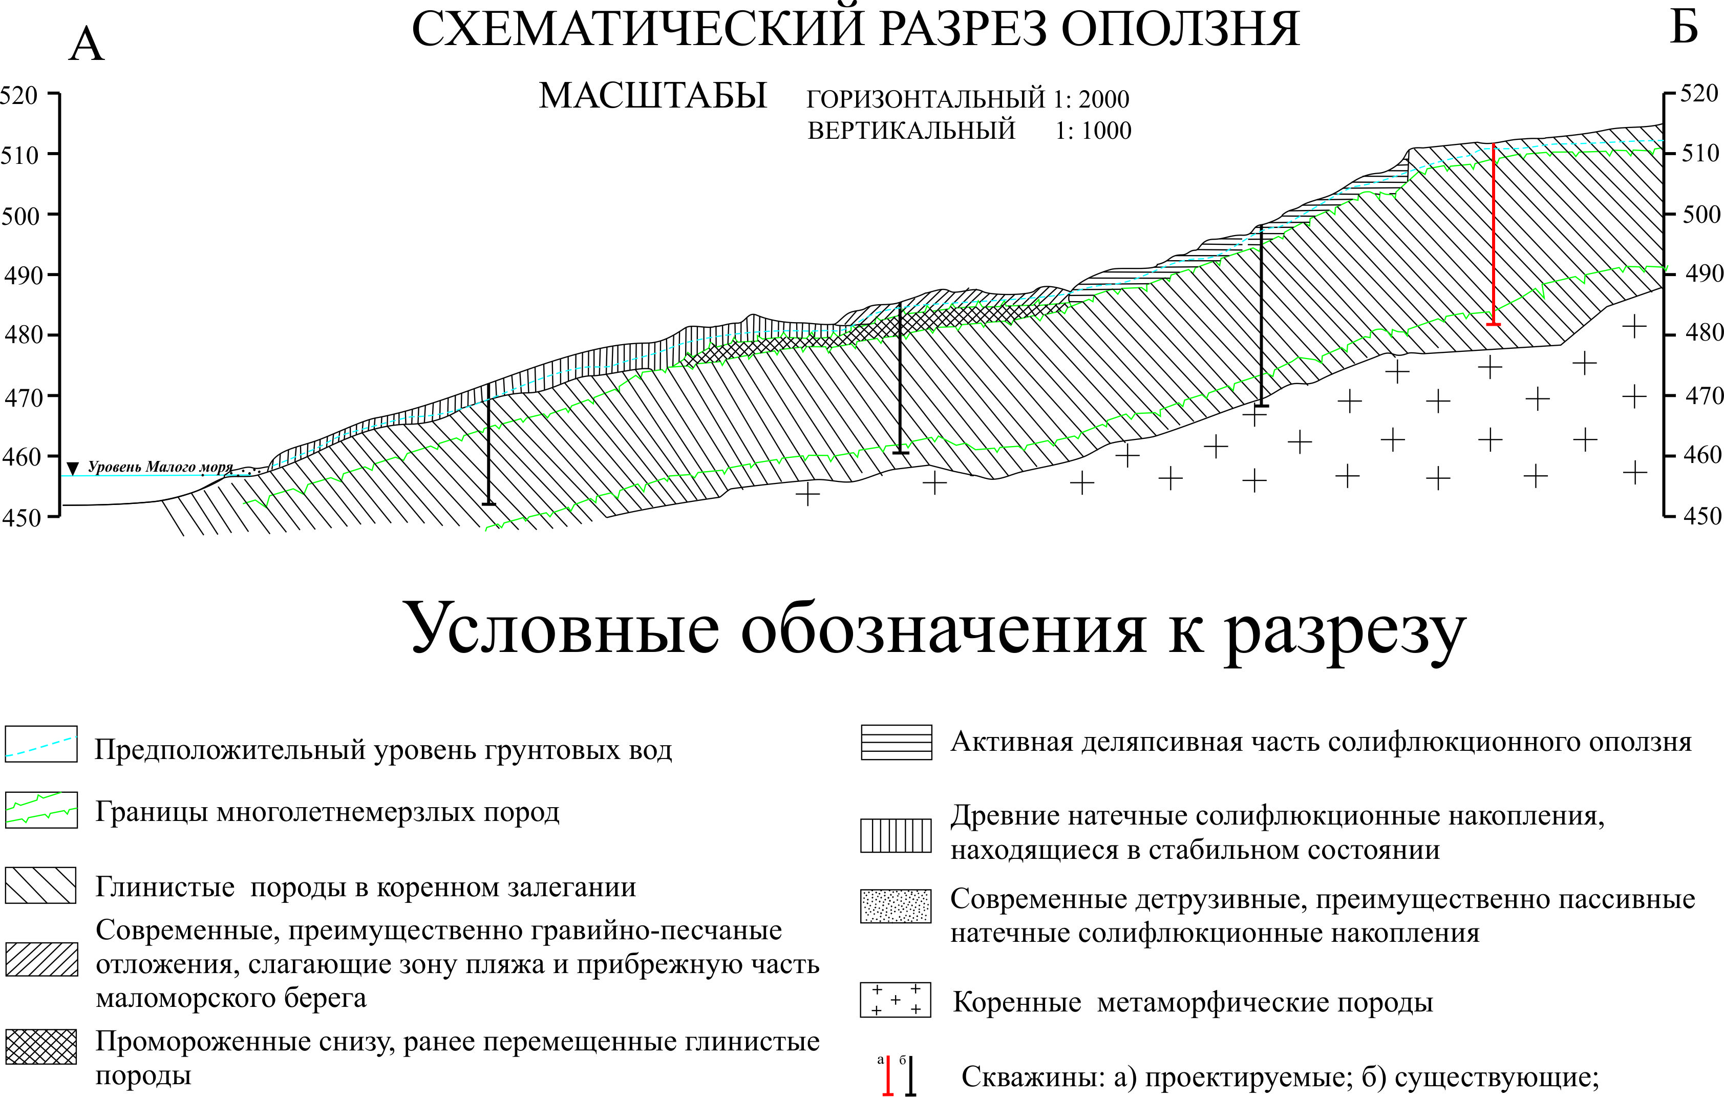
ENGINEERING GEOLOGY AND GEOECOLOGY DEPARTMENT
Scheme of a landslide transect
Due to a change of temperature regime and enormous amounts of precipitations the landslides are appeared and can be moved from hills to coastal zones. Such geological processed should be assessed by forecasting modeling.

Slide 27
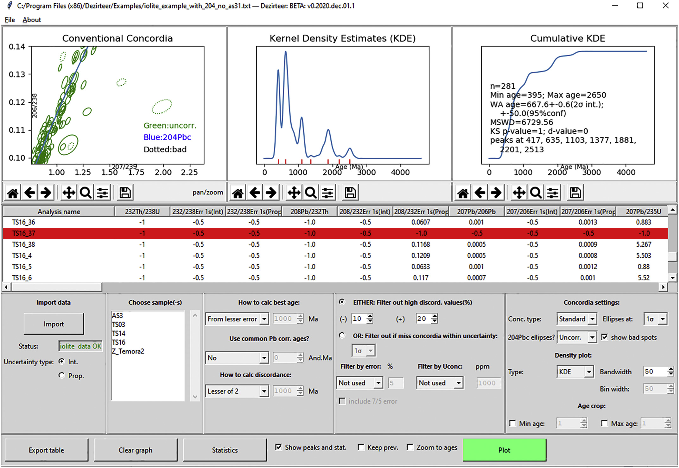
ISOTOPE ANALYSIS DEPARTMENT
Kernel Density Estimation (KDE) is a new approach for U-Pb dating of detrital zircons (crystals, which become darker by radiation). KDE accounts uncertainties of physical measurements, but depend on age of the zircons. The problem is to model KDE parameters and optimize them.

Slide 28
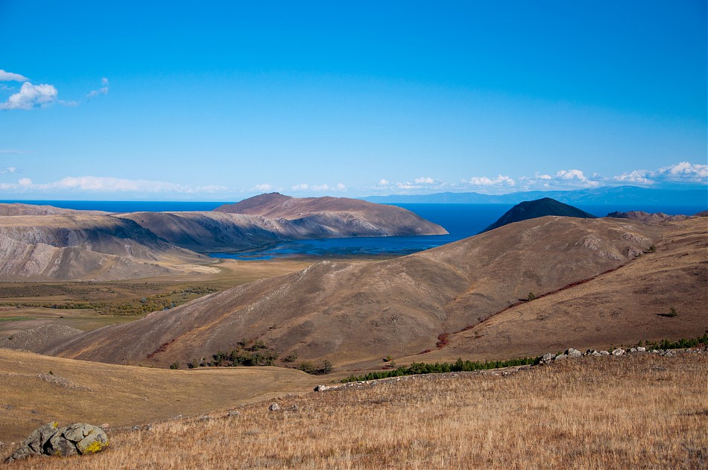

THANK YOU FOR YOUR ATTENTION!

